Slide 1
Energy-Efficient Computing: Do We Have A Roadmap?
Peter Kogge
McCourtney Prof. of CSE, Univ. of Notre Dame
IBM Fellow (retired)
Cray, IEEE Computer Pioneer Awardee

Slide 2

Computing Has Reached the “Cambrian Explosion”
Cellular Automata
Map Reduce
Systolic Arrays
Petri Nets
Actor model
Lambda Calculus
Combinators
Logic Computing
Reversible
Probabilistic
Functional
Data Flow
Neural Morphic
Adiabatic
Analog-Electrical
Analog-Mechanical
Genetic
Ising
DNA
Fluidics
Optical
Quantum
Coupled with growing irregularity, sparsity, transitory computation,
what “consumes” power is changing!

Slide 3
What is Energy-Efficient Computing?
We Don’t Mean Just:
Lower energy/flop
Lower node power
Lower energy per computation
We Do Mean:
Lower Overall Energy At Performance Comparable or Better Than What Is Achievable Today
At the Same Size Problems, Or Bigger
Will Require ATSAA:
Architecture/Technology/Software/Algorithm/Application Codesign
Particularly Science specific

Slide 4
First Observation: Evolution of Challenges
2000: DOE Report “Scientific Discovery through Adv. Computing”
Beginning of ubiquitous parallelism
Challenge: Make full use of terascale
Critical issues: performance, portability, adaptability
Sim codes 5%-10% of peak – and decreases with parallelism
2008 Exascale Study: Need much tighter tie-in to architecture
Design for energy
E,g. Computing energy of Iso-octane
275M nonlinear equations
Iterative solution
2.5PB between processors
15 TB to disk
30 PFlops

Slide 5
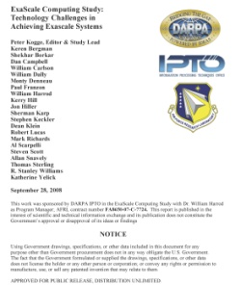
The 2008 Exascale Eye-Openers
Energy/Power was the dominant factor
Only path forward
Simpler chips at less than max clock rates but massive parallelism needed
Alternative packaging
High degree networks
Must deal with greatly reduced memory bandwidth per op
Dongarra, J., Keyes, D. The co-evolution of computational physics and high-performance computing. Nat Rev Phys (2024). https://doi.org/10.1038/s42254-024-00750-z

Slide 6
Topics
The Road to Exascale: Lessons Learned
Deep Dive on The Past
Technology Advances
Projections to Zettascale
Non-Obvious Research Directions

Slide 7
Review: The Road to Exascale
Includes content from “Frontier vs the Exascale Report: Why so long? and Are We Really There Yet?” by Kogge & Dally, SC 2022

Slide 8
The HPL World in 2008
Roadrunner: 1+ PF/s
DARPA (Bill Harrod): Exa by 2015?
2008 Exascale Report: Yes, but…
Exa Goal
*
10¹⁸ Flops/s
Roadrunner
10¹⁵ Flops/s
ASCI Red
“First Light” for new TOP500 entries

Slide 9
The HPL World in 2022
2022: Frontier Cracks 1EF/s
7 years after Report Goal
4 years after extrapolating curve
Bounding Curve Changed in 2013
*
Frontier
Exa Goal
*
10¹⁸ Flops/s
Roadrunner
10¹⁵ Flops/s
Obvious Questions
What Is/Was Exascale?
What Did 2008 Report Predict?
Comparison to Frontier
What did Report get Right/Wrong?
ASCI Red
“First Light” for new TOP500 entries

Slide 10
The Exascale Study Report Outline
What should “Exascale” Mean?
The 2008 state of the art
Architectures, Runtimes, Programming, Metrics
2008 Application Characteristics
Computation vs Memory intensive Apps, Scaling, Concurrency
Technology Roadmaps
Logic: Silicon and Non, Memory, Storage, Interconnect, Packaging, Resiliency, Programming Models
Strawman Designs
Subsystem projections, Evolutionary designs (Heavy and lightweight), Aggressive design
Challenges & Research Areas
Power, power, power, & power
Memory capacity & bandwidth
Programmability
Reliability
Blue: Addressed here
Remain
Practically Solved

Slide 11
What Was Exascale?
Report Emphasis: Try to change focus from flops
Goal: overall 1000x capability over “Petascale” by 2015
In Same Footprint for Supercomputer at max 20MW
1000X in a rack (peta scale)
1000X in a module (tera scale)
Goal: not just flops but 1000x in:
Memory
Memory Bandwidth
Network Bandwidth
…
Plus ability to efficiently use massive concurrency

Slide 12
Technologies Investigated
Logic: power, area, energy, clock
CMOS: hi perf/low voltage
Options: hybrid, superconducting
Voltage scaling
Main Memory
SRAM, DRAM, NAND, Alternatives
Reliability, packaging, power
Storage Memory
Disk, Holographical, Archival
Interconnect: esp. energy
On chip
DRAM to Processor (Stacking)
Intra/inter module
Rack to rack
Electrical vs optical
Packaging and Cooling
Resiliency & Checkpointing
Programming Models

Slide 13
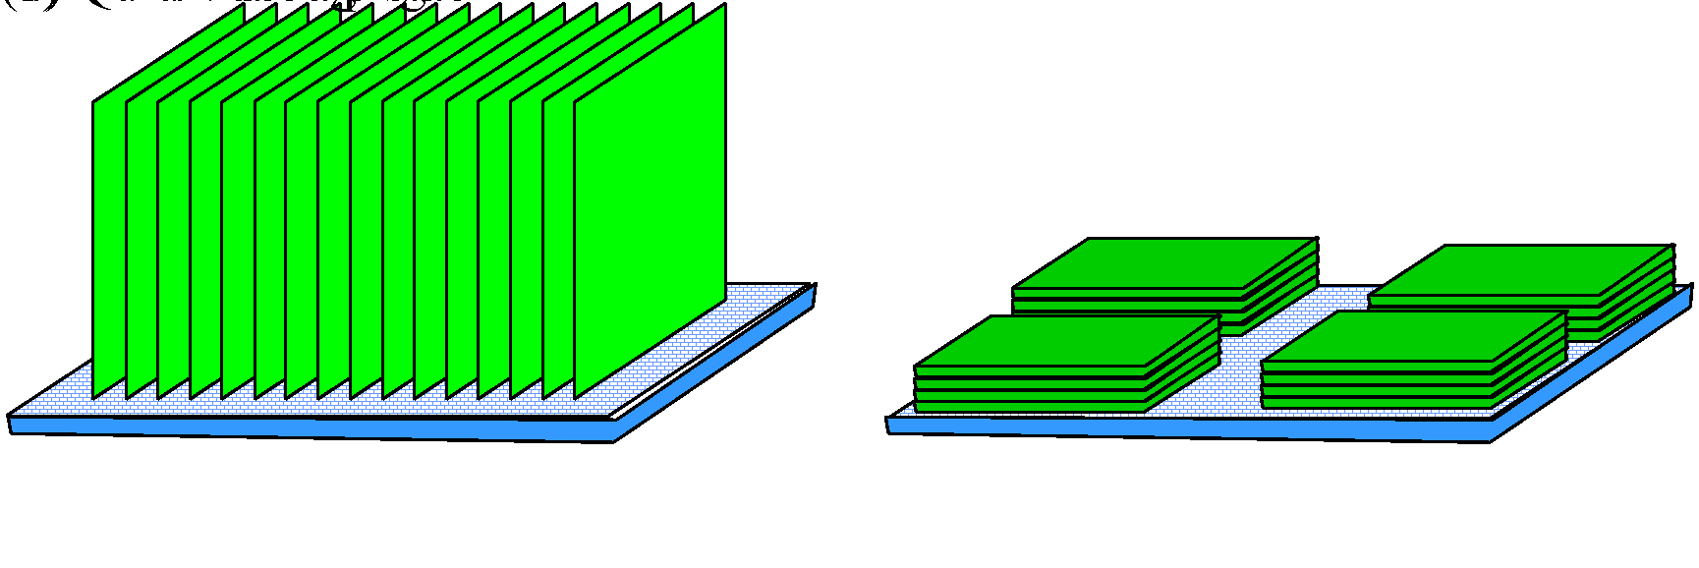
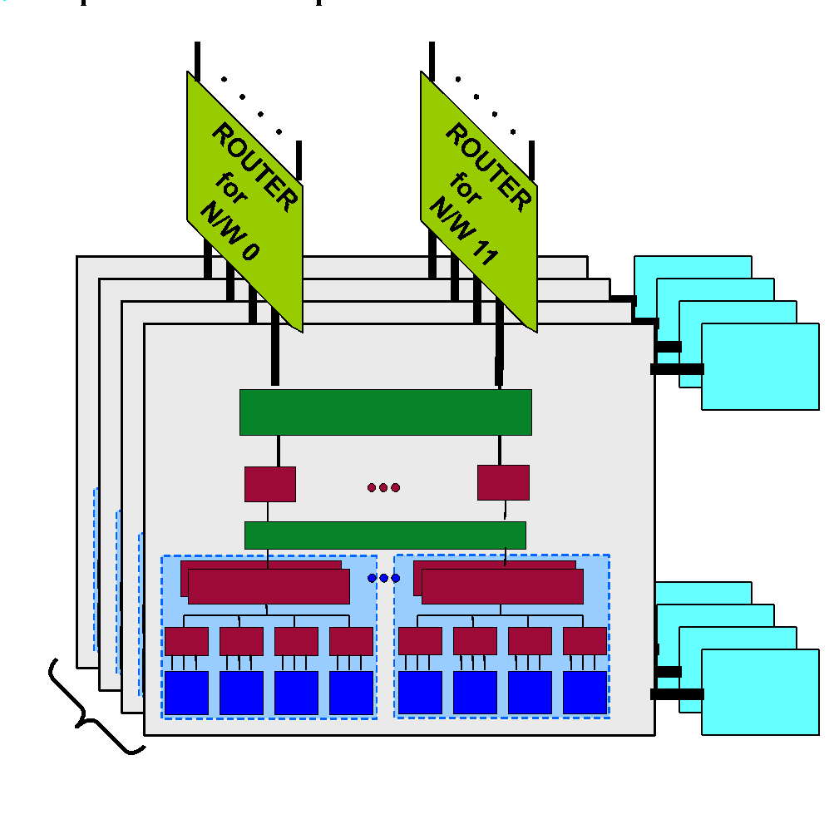
2015 Aggressive Strawman Design (2013 Tech)
Node: 742 simple cores/chip with 4 FPUs @ 1.5GHz
32nm CMOS with 30Gb/s SERDES
16 Memory channels: each 1 GB Stacked DRAM
150 Watts w’o routing chip
Group: 12 nodes with 12 64-radix router chips
Includes 16 12GB SATA drives for checkpointing
Cabinet: 32 Groups = 384 nodes
Assumed max power of 120KW
System: 583 Cabinets, 67MW
3-hop Dragonfly interconnect (optical)
166 million cores with 664 million FPUs
Est. 14.9 GF/W
Or 67 pJ/flop
WD

Slide 14
Power/Energy Constrained Memory Bandwidth
Need to do 164 flops
For each byte of remote
Memory accessed

Slide 15
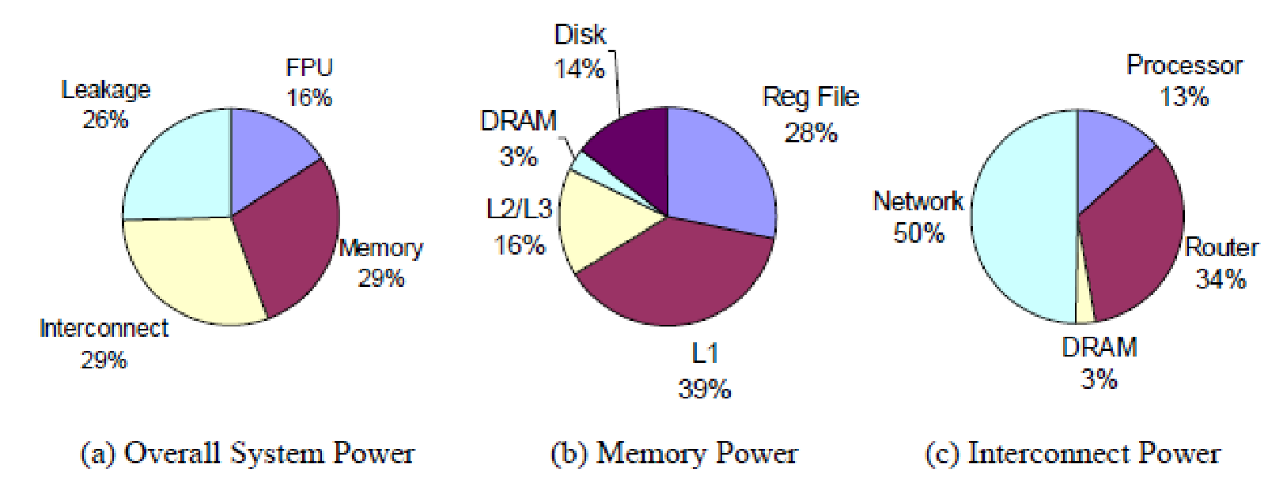
Where Did the Energy Go?

Slide 16
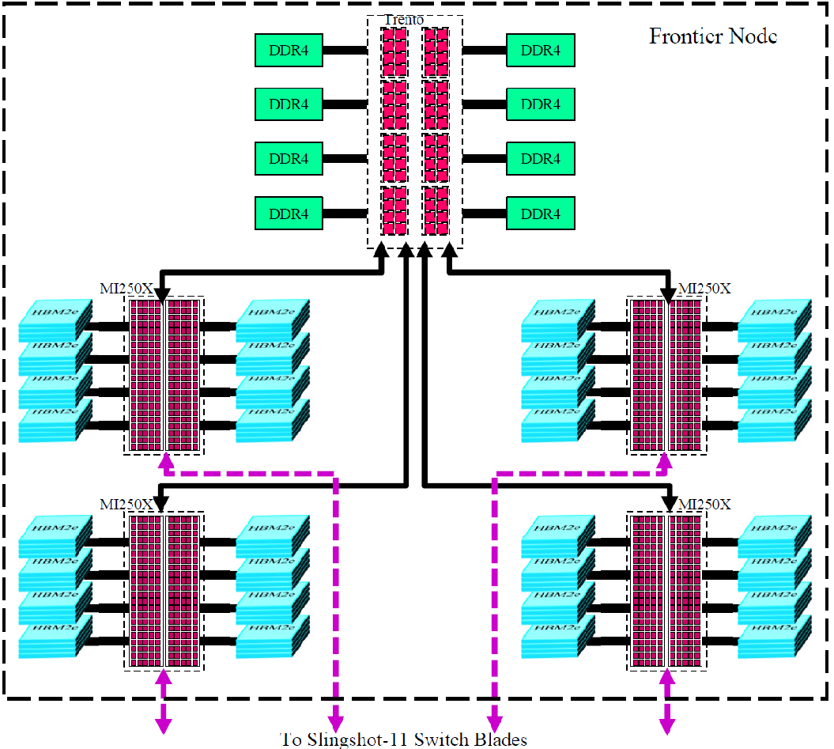
2022 Frontier Node
Heterogeneous Processors
64-core 2GHz CPUs
Quad GPUs: closer to Strawman
But more FPUs/core
And slightly faster
Chiplet design
Mixed memory hierarchy
8 DDR4 DRAM Channels
8 HBM2e stacks/GPU
Quad network ports
Measured 52.2 GF/W
~3.3X Strawman
PMK

Slide 17
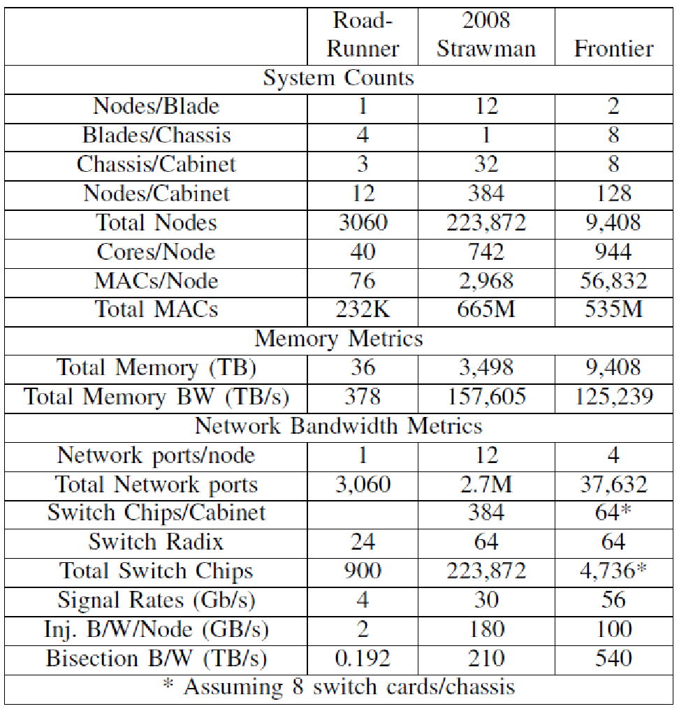
Frontier vs Strawman
Strawman’s huge #s of nodes
Exploded # of Network ports
And thus huge switching costs
Frontier had fewer, bigger nodes
Reduced network ports
Comparable Memory Bandwidth
Use of wide stacked memory
But only 3X capacity
Essentially same N/W topology
But 2X better SERDES
And 2+X better bisection B/W
WD

Slide 18
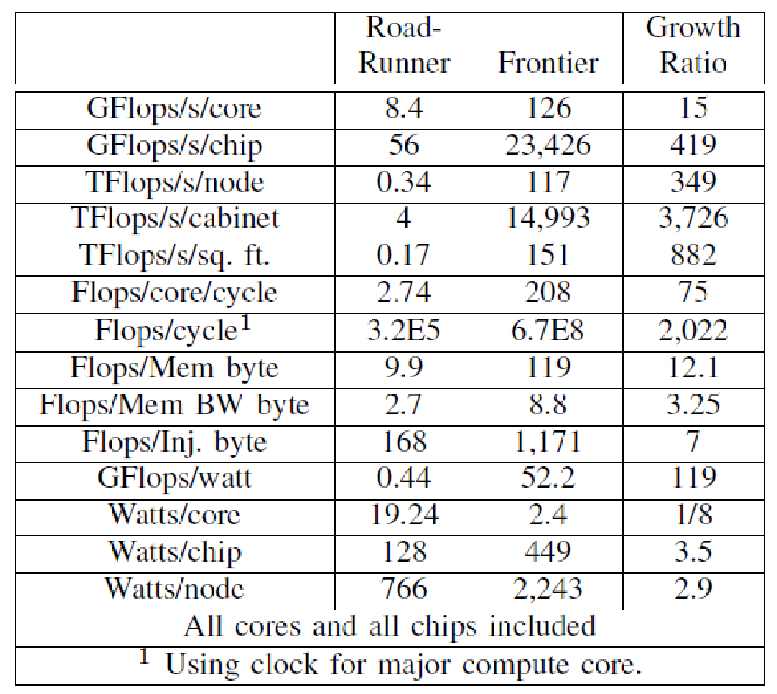
Frontier vs Roadrunner: Did We Get 1000X?
Flops/s exceeded 1000X / cabinet
But huge cabinets
Within 3X for chip & node
Only ~100X in flops/s per watt
And flops/cycle
Miserable increase in Memory, Memory Bandwidth. N/W Injection Bandwidth

Slide 19
Report Card
What We Got Right
What We Missed
CMOS, flat clocks
Large # of wide simple cores
Aggressive memory hierarchy
Stacked memory
Near reticle-limited dies
Energy of movement predominates
Near billion-way concurrency
Memory concerns were valid
Dragonfly with hi radix switches
N/W signaling rate would improve
Heterogeneous designs
SIMD width much larger
Stacked memory: more ports/lower transfer rate
Machine Learning & short FP
Massive 500W chips
Reliability not a show-stopper
New programming models

Slide 20
What about “Zettascale”

Slide 21
Industry Projections: Road to 1 Zettaflops/s
2018: China NUDT: 2035 is reasonable
Moving from exascale to zettascale computing: challenges and techniques. Frontiers Inf Technol Electronic Eng 19, 1236–1244 (2018). https://doi.org/10.1631/FITEE.1800494
2021: Intel: 2027 may be possible
Raja’s chip notes lay out intel’s path to zettascale. https://www. servethehome.com/rajas-chip-notes-lay-out-intels-path-to-zettascale/, 2021
2023: AMD: 2035 is reasonable
https://www.hpcwire.com/2023/02/21/a-zettascale-computer-today-would-need-21-nuclear-power-plants/
All assume power budget 50-100MW

Slide 22
NUDT’s 2018 Projection for 2035
Technical Challenges: Manufacturing, Energy, Interconnect, Storage, Reliability, Programming
Expected changes
Architecture: heterogeneous, mixed precision, near-memory, non-von Neumann
Package driven: 3D integration, inter-chip interconnection,density per node to 0.5-0.8 Pflops/s @0.8 Tflops/W
Network: electrical to exceed 50Gb/s, optical CWDM to 112Gb/s per channel, on-die photonics
Storage: 3D stacks, hybrid multi-layer storage, NVM, Network attached memory
New technologies: memrister, quantum
Programming: MPI+X, with variety of intra-node threading models, DSLs
100,000 Nodes
1000W per node
Only 1.5X more floor space implies100KW per sq. m of floorspace, or 3.2X more power per rack

Slide 23
Intel 2021: Zettaflops/s by 2027-28
Goal: same power as ~2Eflops Aurora
Architecture: 16X – “AI Math” + keeping execution units fed from memory
Power/Thermals: 2X – Lower voltages and higher-end cooling (eg liquid cooling but more than rear door heat exchangers
Data Movement: 3X – higher integration, fewer better SERDES
Process: 5X - multi-tile design with advanced packaging that allows technology mix
Phase 1: 2022-23 Exascale+
“Granite Rapids”
Phase 2: 2024-25 Pre-Zetta
“Falcon” = Xeon + Xe
“Lightbender” = Silicon photonics
Phase 3: 2026-28: Zetta
Reduce 50MW Exaflop-class to 50KW
Requires all changes from left

Slide 24
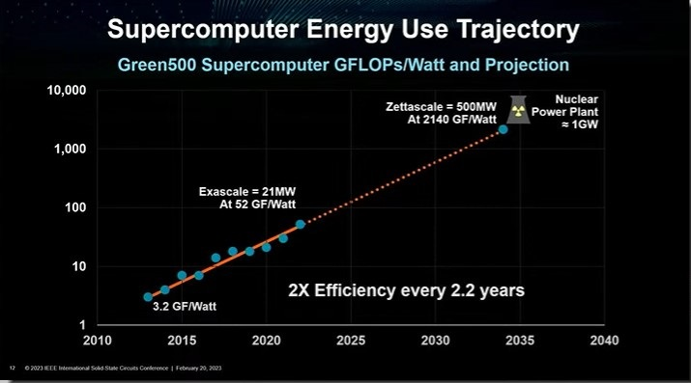
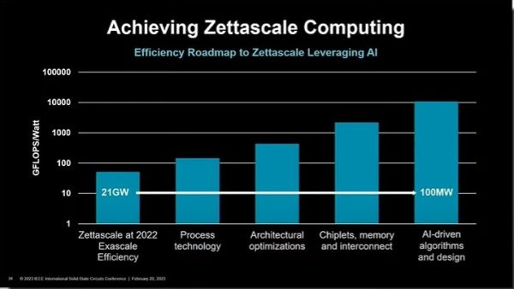
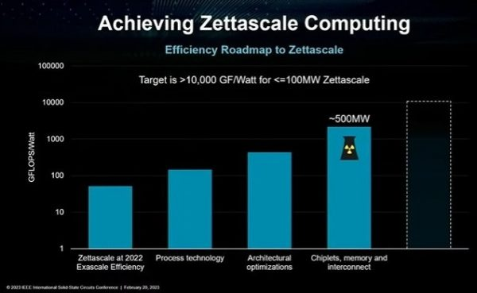
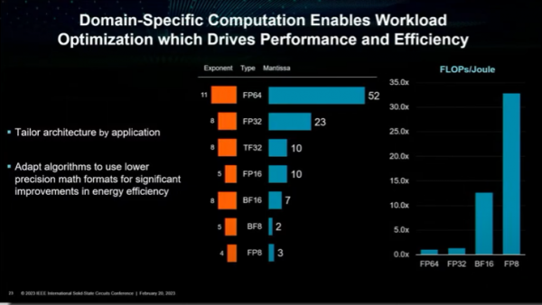
AMD: Need to Use “AI”
1
3
-5X-
-5X-
-3X-
-3X-
2
4
Missing 5X
https://www.hpcwire.com/2023/02/21/a-zettascale-computer-today-would-need-21-nuclear-power-plants/

Slide 25
Clear Takeaways
Focus seems to solely be on flops/s
Energy efficiency the major challenge
Power budgets of 100MW imply need 200X in efficiency
No silver bullet from “traditional” architecture
Process improvements small (3X?)
Bulk of improvement riding on packaging, esp. 3D
Much hope on “AI” – i.e. mixed precision
Memory/networks mentioned but not any real thought

Slide 26
Deep Dive on The Past: An Energy Focus

Slide 27
The Multi-Faceted World of 2020s
“First Light”: 1st appearance
Color=Benchmark
HPL
HPCG
HPL_MxP
BFS
SSSP
Fill
Solid: with GPUs
Hollow: without

Slide 28
CAGR
HPL: 1.2
HPCG: 1.13
BFS: Flat
10X in 12 years
5X in 12 years
HPL
HPCG
HPL_MxP
BFS
SSSP

Slide 29
Seems to have been ~ constant since ~2018
“System” power/core >> chip power per core
We need to look at “system”

Slide 30
Today’s Node Design – Energy of Movement
Same colors = similar functions
GPU Module:
PC card to Proc Module
Substrate to GPU chip
On-GPU chip networks
Chip-substrate to HBM
HBM Stack:
Substrate to GPU
Chip-chip to memory die
Switch Module:
Chip to Network
On-chip networks
Processor Module
Processor Chiplet
On-chip Network
Chip-chip to cache die
Chip-substrate to IO die
Processor Chiplet
On-chip Network
Chip-chip to cache die
Chip-substrate to IO die
IO Chiplet:
Chip-substrate to Proc die
On-chip networks
Chip-substrate to HBM
Chip-module-PC card to GPU
Chip-module-PC card to DRAM
Chip-module-PC card to NIC
NIC Module:
PC-card to Module
On-chip networks
Chip-substrate to HBM
Chip to Network
Processor Chiplet
On-chip Network
Chip-chip to cache die
Chip-substrate to IO die
Processor Chiplet
On-chip Network
Chip-chip to cache die
Chip-substrate to IO die
Processor Chiplet
On-chip Network
Chip-chip to cache die
Chip-substrate to IO die
Processor Chiplet
On-chip Network
Chip-chip to cache die
Chip-substrate to IO die
Processor Chiplet:
On-chip Network
Chip-chip to cache die
Chip-substrate to IO die
Lots of On & off chip
Networks/crossbars
DRAM PC Card:
PC card to DRAM Die
Chip-Chip to stacked DRAM

Slide 31
Technology Advances
A Quick Subset

Slide 32
Lower Operating Voltage – No Free Lunch
Lower voltage implies lower energy per operation (good)
Implies lower clock rates
Implies more parallelism needed
Requires more paths for interconnect
And more data movement
And more power spent in data movement (bad)

Slide 33
And What About Memory?
Assume characteristics scale as they did from Peta to Exa
Relative capacity dropping
Can problem size scale with flops?
Is being able to access a word of memory every 400 flops acceptable?
With all the deep cache hierarchies how much extra data transfers between memories are there?
All of which consume power
 | Petaflops/s | Exaflops/s | Zflops/s
 | Roadrunner | Frontier | At same ratio
Capacity (Bytes) | 0.036PB | 0.009EB | 0.0025ZB
Bytes per flops/s | 0.032 | 0.0075 | 0.0025
Bandwidth (Bytes/s) | 0.378PB/s | 0.125EB/s | 0.04ZB/s
Bandwidth per flops/s | 0.344 | 0.105 | 0.04
Flops per Byte | 3 | 10 | 25

Slide 34
At Best Modest Gains in PHY/SERDES Energy
 | 2008 Projection | Recent
Data Movement | Energy | Bandwidth | Energy | Citation
Chip-chip vertically on Thru Silicon Via | 0.01pJ/b
Long range on chip | 0.018pJ/b/mm
Chip-chip copper | 2pJ/b | 224Gb/s | 3pJ/b | ISSCC 2024 Paper 7.3
Routed Interconnect | 2pJ.b + 1pJ/b per switch
Optical | 1.5pJ/b + 0.1pJ/bit for routing | 224Gb/s | 1.04pJ/b | ISSCC 2024 Paper 7.2

Slide 35
My Thoughts
Need to consider more than HPL
Solution has to be heterogeneous & hybrid
Integration of “AI” beyond just mixed precision
Need to seriously reconsider “Probabilistic” algorithms
More specialized computation will move:
Closer to CPUs on die/module
Further from CPUs into memory and network
Levels of parallelism will seriously explode
Places more stress on networking
We cannot afford deep S/W stacks to start computations “over there”
Memory system given short shrift

Slide 36
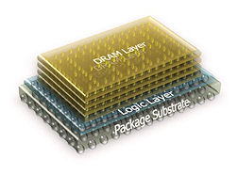
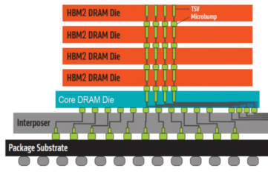
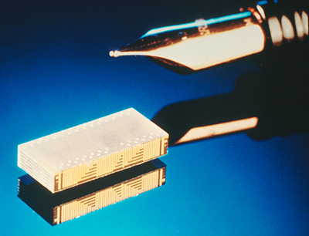
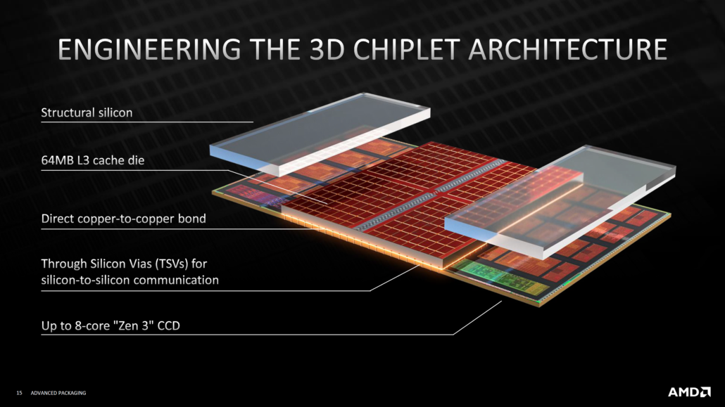
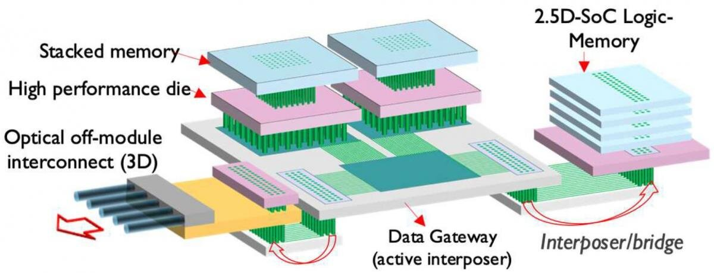
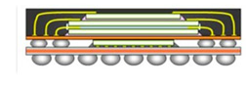
Stacking: Reduce Die-Die Energy Cost
1990s Irving Sensors Die Stack
2011 MICRON HMC
Modern HBM
2008 Exascale Strawman
AMD 3D Stacked V-Cache
https://scx2.b-cdn.net/gfx/news/2021/benefits-of-3d-soc-des.jpg
Apple 2012 iphone chip stack

Slide 37
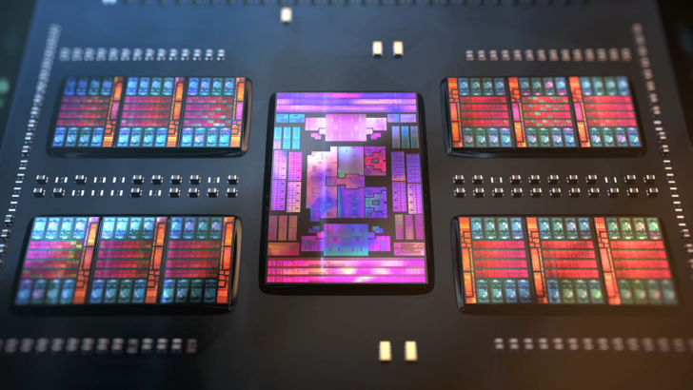
Chiplets
Chiplet: Breaking large tiled die into multiple smaller die
And place on substrate not PC
With lower energy per bit transferred
Reason: Increase yield => Lower cost
Also promote “mix & match”
Side-effect: Increased off-die contacts
Each will consume energy
AMD Genoa 12x16C Chiplets
I/O &
Memory
Chiplet
Silicon Interposer
16 die/system
Torus
1 die/system
Mesh
1D

Slide 38
ISSCC 2024 – New Architectures Sessions & Forums
15: Embedded Memories & Ising Computing
17: Emerging Sensing and Computing Technologies
20: Machine Learning Accelerators
29: ICs for Quantum Technologies
30: Domain-Specific Computing and Digital Accelerators
34: Compute-In-Memory
F1: Efficient Chiplets and Die-to-Die Communications
F2: Energy-Efficient AI-Computing Systems for Large-Language Models
F3: Digitally Enhanced Analog Circuits

Slide 39
Examples of Novel In-Memory Accelerators
SRAM ISING In-memory Optimizer (ISSCC 2024 15.5)
Post Quantum Crypto-processor (ISSCC 2024 16.2)
74TF/s BF16 Compute-In-Memory for Diffusion Models (ISSCC 2024 20.2)
Compute-In-Memory PINN
(ISSCC 2024 20.4)
Compute-In-Memory Spiking Neural Net
(ISSCC 2024 30.2)
Compute-In-Memory SAT Solver
(ISSCC 2024 30.3)
In-Memory Annealing Processor
(ISSCC 2024 30.4)
Compute-in-Memory with 31.2TFLOPS/W(ISSCC 2024 34.8)

Slide 40
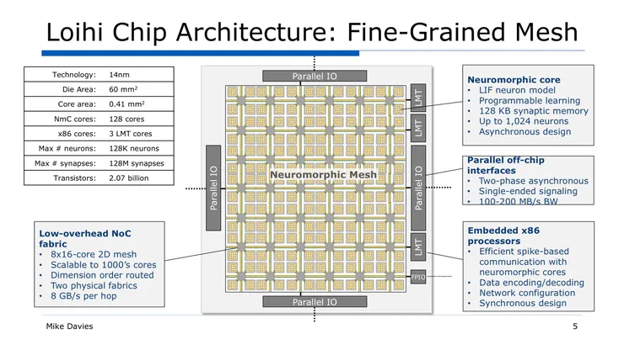
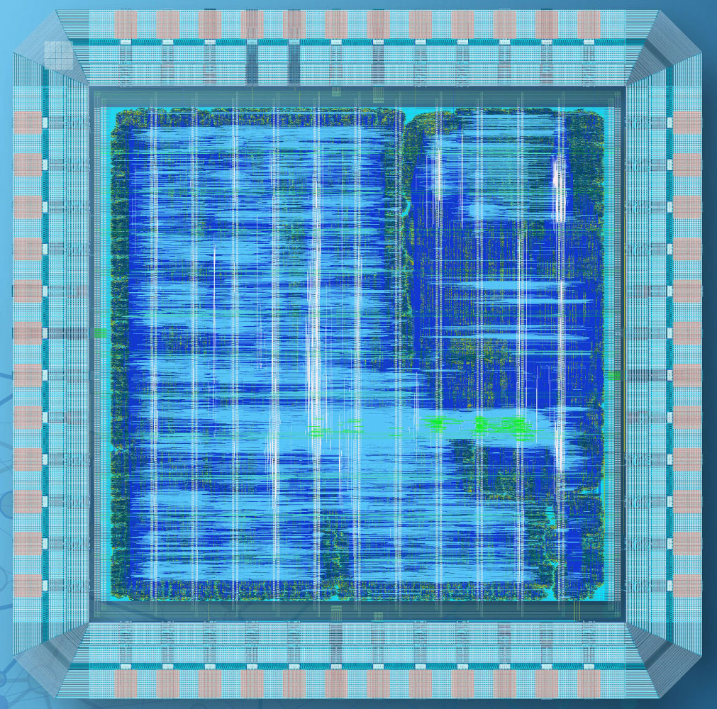
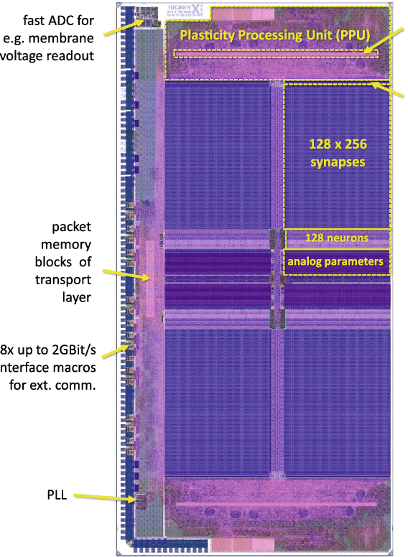
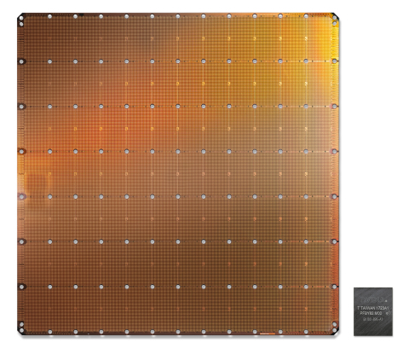
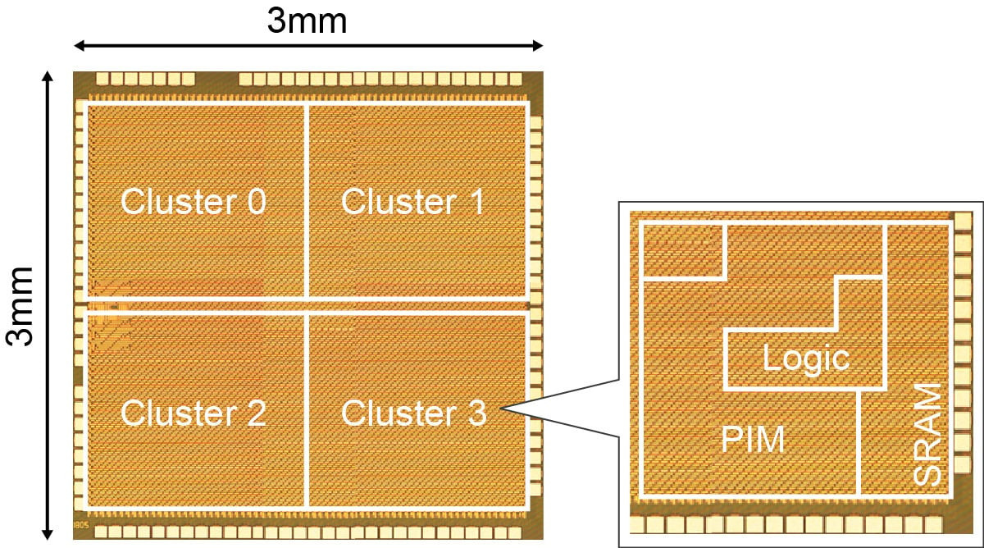
Spiking Neural Net Accelerators
Intel
IBM TrueNorth CHip
IMEC
Renesas 8.8TOPS/W
BrainScale S-2 Chip
Cerebras Trillion Transistor Chip

Slide 41
Diving into Cross Node Communication Costs in Parallel Codes - and Their Energy Impact

Slide 42
Example Effects of Imperfect Parallel Scaling
Underlying Problem: Growing Transient Computation

Slide 43
Amdahl Model and a Time-Energy Trajectory
A+B/A=1
A+B/A =3
No parallelism
Some serial
component
A+B/A =3
A+B/A=1
A+B/A =10
A+B/A =10
No parallelism
Some serial
component
A+B/A =100
A+B/A =100
A = 0
A = 0
Perfectly Parallelizable
No serial component
Time = A + B/N (N= # nodes)
A = single node serial time
B = single node parallelizable time
Asymptotic speedup = (A+B)/A
B = 0 is “No parallelism”
A = 0 is “Perfectly Parallelizable”
Each line: Same A,B values but with different # of nodes
(1,1): time with a single node
Large marker = 128 nodes
Red line: more nodes just cost energy
Blue line: more nodes speeds up perfectly

Slide 44
A “Cost of Communication” Model
C/T = 5
C/T = 2
No parallelism
C/T =1
C/T = 5
C/T = 2
C/T=0.25
C/T =1
Some serial
component
C/T=0.25
C/T = 0
Code gets slower
With more nodes
C/T = 0
Communication has NO cost
No serial component
Assume a “graph-like’’ model
Multiple edges must be followed
Equally partitioned among all nodes
Compute cost/edge = T
Cost if edge goes off node = C
C/T = 1 is a critical parameter
C/T<1: some speedup
C/T > 1: more nodes counter-productive
Each line: Same C/T values but with different # of nodes
(1,1): time with a single node
Large marker = 128 nodes
Lines with C/T≥1 get worse in energy AND time
Lines with C/T<1: more nodes speed up

Slide 45
Looking at Such Trajectory Graphs Can Help Id Properties of Code
C/T = 2
C/T = 5
Some serial
component
A+B/A=1
C/T =1
A+B/A =3
C/T=0.25
A+B/A =10
No parallelism
A+B/A =100
A = 0
C/T = 0
Perfectly Parallelizable
Code gets slower
With more nodes
Communication has NO cost
Curves like this imply an Amdahl Model
Curves like this imply a Communication Model

Slide 46
Example: Subgraph Isomorphism
Find instances of complex subgraph in a very large graph
Multiple parallel implementations
Mig. Threads need no comm s/w
Takeaway: Best of conventional must use 87+% of its cycles in handling inter-node comm
We’ve seen similar results in ML, SpMV, …
13,300
Cilk on Single Node
Modern Multi-core, Multi-n0de
3560
Migrating Threads
466
See Kogge, McMahon, Dysart, HPEC 2024

Slide 47
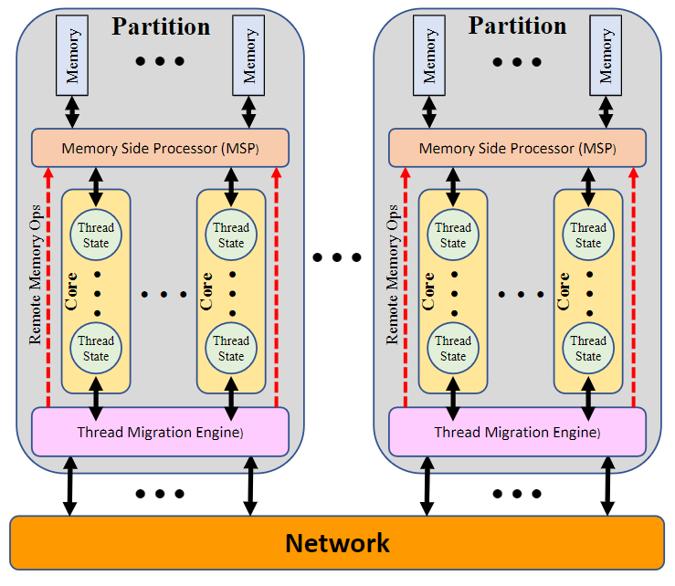
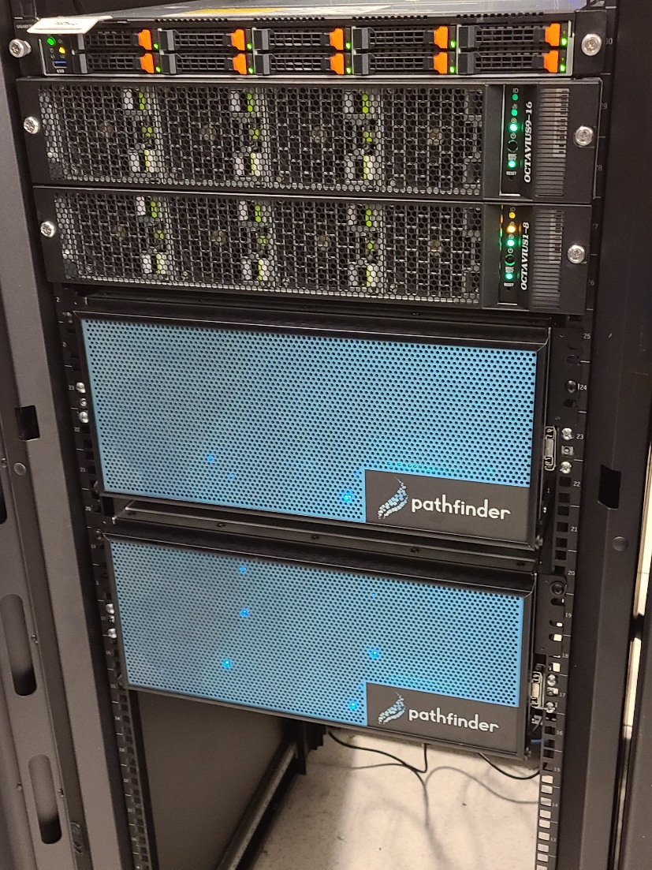
An Example of A New Architectural Technique
Migratory Threading
All memory on a single logical space
On nonlocal reference: H/W
Suspends thread
Packages State
Sends to correct node
Unpacks State
Restarts thread
Cheap spawns
32 node Lucata Pathfinder
at GaTech’s Rogue’s Gallery

Slide 48
Actual Performance/Energy Trajectories
Joules = Power * Time
Each Curve: same dataset but different nodes
Closer to Origin is better
Solid Curves: 78M Edges
Dashed Curves: 38M Edges
Red Lines: Modern 128 core 2.8GHz nodes
Green Lines: Older Cluster with 3 GHz cores
Blue lines: Pathfinder (CRNCH resident) Migrating Thread system with 180MHz
Conventional Systems Appear to have Communication Model characteristics
Migrating Threads far more scalable
At higher performance per clock
Cilk on 1 node
Puma
Prolog on 1 laptop core
But smaller dataset

Slide 49
My Suggested Research Directions

Slide 50
Three Major Research Components
Promote “Benchmarking for Understanding”
Architect to reduce inefficiencies due to “border crossings”
Develop flexible “hybrid” algorithmic techniques

Slide 51
#1: Benchmarking for Understanding
Reasons for Benchmarking
Benchmarking “Crimes”
Today
Competitive benchmarking: “my system is better than yours”
Technical benchmarking: “I get best performance with parameters xyz”
Projective benchmarking: “by looking at previous generations the next Moore’s Law increment tech level should increase performance by X”
Selective benchmarking,
Using wrong benchmarks,
Improper comparison of results,
Improper interpretation of results,
Measurement omissions
Internal
See G. Heiser, “Systems benchmarking crimes,” https://gernot-heiser.org/benchmarking-crimes.html

Slide 52
Current Benchmarks (From Upcoming Paper)
Inadequate for
“Understanding”

Slide 53
The Benchmarking Bridge
Goal: Institutionalize process:
To enable deep understanding how computational infrastructure affects performance
As a function of benchmark characteristics

Slide 54
We Need to Capture Cross-Benchmark Data

Slide 55
Expanding Scalability Studies beyond Kernels
Define kernels and WORKFLOWS:
Compositions of kernels
With multiple data set sizes
To be measured over multiple system sizes
Example: AGILE program from IARPA
Workflow 1: Knowledge Graphs – Groups, Relationships, and Interests
Workflow 2: Detection – System and Event Patterns
Workflow 3: Sequence Data – Identification and Clustering
Workflow 4: Network of Networks – such as Cyber-Physical Systems
Each with several variations
Include instrumentation to track major energy-costly events
i.e. Not just the highest performance but how does app/infrastructure scale – both strong and weak

Slide 56
#2: “Border Crossings”: The New Bottleneck
Today
Tomorrow
GDDR
GPU
Socket
GPU
Socket
GDDR
.
.
.
.
.
.
HBM
HBM
GDDR
GDDR
DDRx
.
.
.
General
Purpose
Socket
General
Purpose
Socket
DDRx
.
.
.
HBM
HBM
DDRx
DDRx
DDRx
.
.
.
General
Purpose
Socket
General
Purpose
Socket
DDRx
.
.
.
Near/In Memory
Accelerators
HBM
HBM
DDRx
DDRx
At least three kinds of computational “crossings”
Physical separation of computational units
Change in ISA/Execution model
Significantly different engine technologies
Network Interface Chip

Slide 57
#3: Innovation in “Hybrid” Algorithms
Hardware is going heterogeneous
Codes will bounce between different “cores”
Algorithms are rapidly involving new models of computation
AI, Quantum, Analog in Memory…
We need to understand algorithms that do both
EFFICIENTLY without wasting processing cycles

Slide 58
History (and Future) of Algorithms
Technique | Repeatable Results | Bounded Precision | Execution Time
Direct Solvers | Yes | Within roundoff | Predictable
Iterative Solvers | Yes with same seed | Usually testable | Iterative improvement
Monte Carlo | Yes with same seed | Math bounds | Iterative improvement
ML-based | Yes | Weak | Fixed (Inferencing)
Quantum | No | Distribution | Needs multiple runs
As we move down
Solutions get faster
Likely to be more hybrid, heterogeneous
“Accuracy” becomes less well-defined
Need to understand “costs” of hybridization
Classical
Run
Parameters
Result
Measurements
Analog/AI/Quantum

Slide 59
ML/AI Discussion
Example of Solovlev Equilibrium
Use as universal function approximators
Learning: Discover equation (learn from solvers or experimental data)
Inferencing: Replace conventional solvers
PINNs: Physics Inspired Neural Nets
Designed with classes of ODEs/PDEs in mind
Train to find coefficients
Techniques exist to architect NN for dynamically adjustable time/accuracy
“A hands-on introduction to Physics-Informed Neural Networks for solving partial differential equations with benchmark tests taken from astrophysics and plasma physics”, https://arxiv.org/pdf/2403.00599v1
See for example: https://towardsdatascience.com/solving-differential-equations-with-neural-networks-afdcf7b8bcc4
Also “Physics-informed neural networks: A deep learning framework for solving forward and inverse problems involving nonlinear partial differential equations.” Journal of Computational physics (2019)

Slide 60
Summary: My Suggested Research Directions
Much of new technology will be researched by industry
Rapid escalation in heterogeneity
Research focus should be on improving energy efficiency for Science apps using alternative models
Understand where are energy-inefficient events
Develop architectures that avoid inefficient border crossings
Design algorithmic techniques that reflect changing nature of computing
Understand
Benchmark
Results
Codesign to
“Right-Size”
Node Designs
Architect around
Inefficient Changes to
sites of computation
Develop algorithmic
Techniques to
Leverage new
Computational models

Slide 61
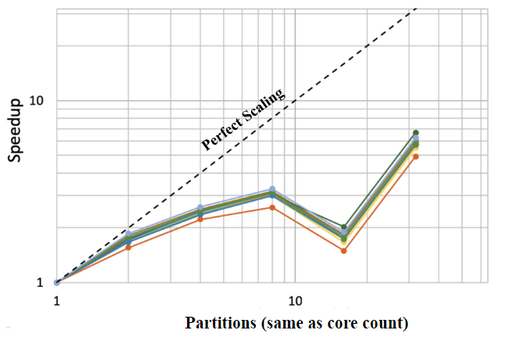
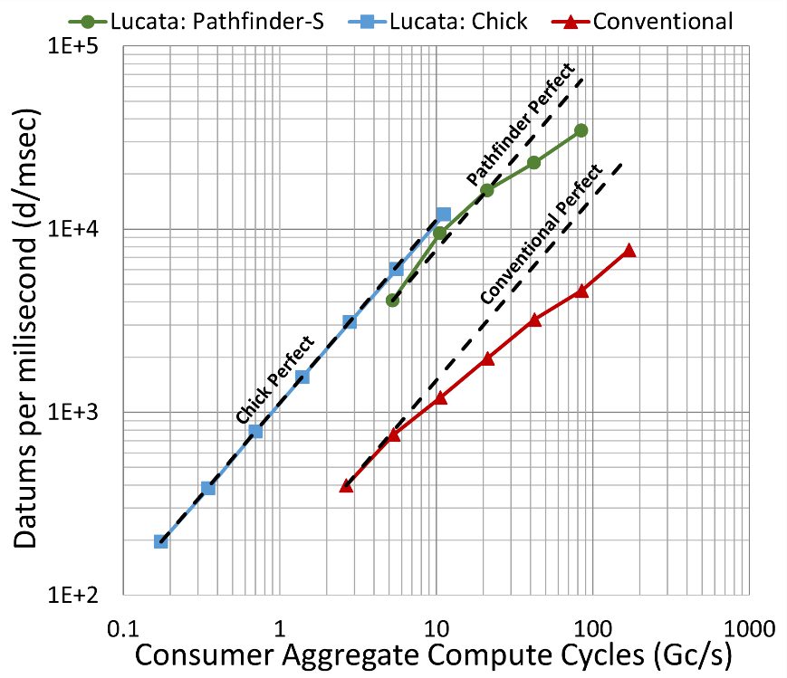
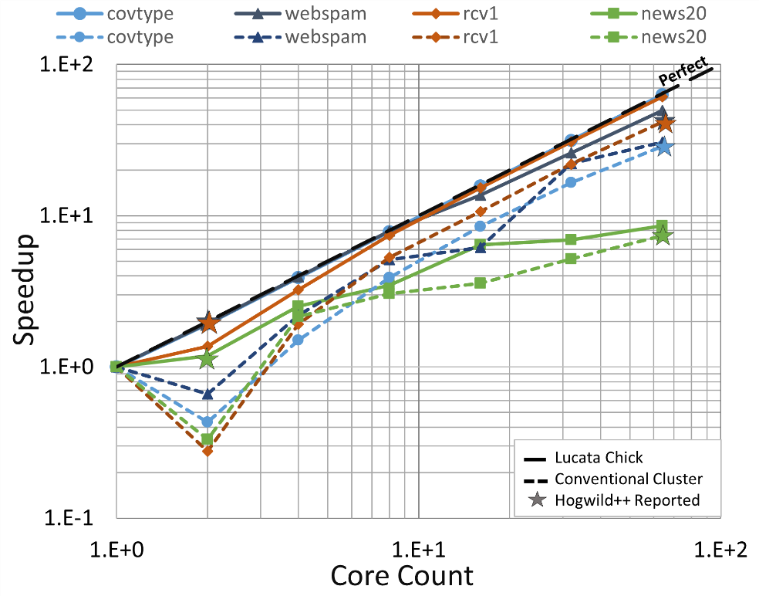
Apps using just Migrating Threads
Sparsest of SpMV Cases
Firehose Streaming
ML SGD SVM
Far better scaling on sparsest cases

Slide 62
Possible Growth to Interfacing Heterogeneous System
No coherency traffic
Very fast atomics
No S/W stack for comm
H/W supported spawns
Memory
Memory Side Processing
Near-Memory
Operations
Network
Interface:
H/W
Transport
Thread States
Migrating
Thread
Multi-Threaded
Core(s)
Spawn
Interface
Accelerator
Core(s)
Accelerator
Core(s)
Accelerator
Core(s)
Thread
States
See “Preparing for Future Heterogeneous Systems Using Migrating Threads”, ExHET Workshop, PPOPP, Edinburg, Scotland, March 2, 2024

Slide 63
“Zettascale” in 2036?
Zettascale HPL (10²¹ 64b flops/s) not feasible
64bit FPU might go from today’s 10pJ to 2-3pJ
Just math path of ZettaFLOPS HPL machine would consume 2-3GW
Better: 1000X for today’s critical apps in same footprint
Multi-physics esp. Climate modeling; Molecular dynamics; …
Machine Learning; Bioinformatics; …
Non-starter: Technology scaling
Effective gate lengths may drop 3+X to 1-2nm
But metal pitch unlikely to improve significantly
3D stacking might give 8X, but costly & little energy improvement

Slide 64
Bridges to Zettascale
Efficiency via Specialization
Reduced precision & specialized data types & operators
Memory system specialized to minimize data movement
E.g. 15,000X for bioinformatics accelerator
Reduce design costs via chiplets
Design just the accelerator core, not the whole system
Growth of AI into Scientific Computation
Orders of magnitude improvement on some problems
Explicit Support for Sparsity
Fine grain memory to avoid overfetch
Finer-grained transfer on networks for better small-message traffic
Efficient scatter/gather, pointer walkers

Slide 65
Conclusions
Petaflops to Exaflops took longer than expected
But architecture remarkedly close to 2008 Exascale Report
2008 Study nailed need for SIMD many-core, stacked memory, networks based on high radix switches
But 2013 technology was insufficient
Too many endpoints, too much power lost to movement
Frontier leveraged better technology
With wider SIMD, multi-die packaging, better networks & cooling
More nuanced answer to “Did Frontier achieve exascale goals?”
Yes if flop-intensive
No if memory or bandwidth-intensive

